Slide 1

A Brief Introduction to Case Analysis

Slide 2
To Start
Read a case study several times.
First, read for the basic details, like you would a novel or magazine article. Look at the case exhibits.
What do the exhibits include? What do the case author(s) want you to know about the situation?
After the first reading, think about what jumps out as the key problem in the case.
Read a second time to look for details about specific topics related to the key problem(s): competitors, marketing strategy, management structure, gains and losses.
Highlight phrases and sections relating to these topics and take notes.
Always analyze the exhibits!

Slide 3


Slide 4
1 - Examine and Describe
Examine and describe the business environment relevant to the case study.
Describe the nature of the organization under consideration and its competitors.
Examine general information about the market and customer base.
Indicate any significant changes in the business environment or any new endeavors upon which the business is embarking.

Slide 5
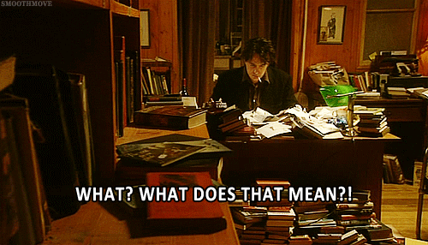

Slide 6
2 – Key Problem(s)
Usually, there will be several factors at play.
Decide which is the main concern of the case study by examining what most of the data talks about, the main problems facing the business, and the conclusions at the end of the study.
Examples might include:
expansion into a new market
response to a competitor's marketing campaign
a changing customer base

Slide 7


Slide 8
3 - Problem Response
Describe how the business responds to these issues or problems.
Draw on the information you gathered and trace a chronological progression of steps taken (or not taken).
Cite data included in the case study, such as increased marketing spending, change of market conditions, market research data, etc.

Slide 9


Slide 10
4 – I.D. Success and Failure
Identify the successful aspects of this response as well as its failures.
Indicate whether or not each aspect of the response met its goal and whether the response overall was well-crafted.
Use specific examples!
What were the goals and were they met?
Analyze broader issues, like the use of marketing mix strategies, to talk about the response as a whole.

Slide 11


Slide 12
5 – Make Your Assessment
Point to successes, failures, unforeseen results, and inadequate measures.
Suggest alternative or improved measures that could have been taken by the business, using specific examples and backing up your suggestions with data and calculations.
Do not suggest alternatives that are not relevant or impossible to implement.
Honor the constraints that are given in the case.
Don’t suggest actions for which there are no resources!
Be realistic, especially with regards to costs!

Slide 13


Slide 14
6 – Recommendations
Describe what changes you would make in the business to arrive at the measures you proposed, including:
Changes to organization itself
New Marketing Strategies
New Customer Segments or Target Markets
Expansion or contraction
Promotion and Advertising

Slide 15


Slide 16
Art or Science?
Case studies are an effective learning tool because there are many ways to arrive at a good strategy.
Often, case analysis is more of an art than a science – it requires creativity and critical thinking!
At the same time, it is more of a science than an art – all the creativity in the world won’t save a flawed analysis.

Slide 17
Typical Presentation Format
Introduction
Key case problems
Critical incidents and interesting case data
Analysis (should be built on what we have been learning)
Marketing mix elements
STP elements
Strategic considerations & concepts present
Possible (relevant) alternatives
Recommendations

Slide 18

What we do not want…

Slide 19
Common Mistakes with Case Presentations
Your presented analysis has little relation to your conclusions.
Leave out analysis that is not relevant
The purpose is not to look smart, but to convince us that your analysis and conclusions will be effective.
Do not simply offer a plot summary of the case.
Assume your audience had read the case, too.
Present only those aspects that support your conclusions.
Sell us on your ideas!
Stick to the time limit and make the most of your time.
Do not present EVERYTHING you covered in your analysis, only what is relevant to your conclusions.
At the same time…do not leave your ideas unsupported

Slide 20


Slide 21
Common Mistakes with Case Presentations
Don’t be boring
You are telling a story with a beginning, middle and end.
Don’t look bored in front of your audience. (Put out the energy that you want back.)
Capture the imagination of your audience.
Be prepared
Do not wait until the last minute to prepare your presentation.
If a group member has not participated in the analysis, it brings the whole group down.
Rehearse! Know who is saying what to avoid “dead air time”.

Slide 22


Slide 23
Common Mistakes with Case Presentations
Organize your group
Do not assume that someone else will do all the work.
Have clear roles for who will complete which aspects of the case, and switch those roles regularly
Analysis
Develop spoken text and presentation bullet points
Develop the final presentation deck
Do not try to present if you have not read the case or participated in the presentation development!
Kindly have your group remove your name from the case and stay seated.
Everyone knows when you don’t know the case.
Nobody will judge you for being nervous, but they will judge you for being unprepared!

Slide 24


